Slide 1
Ignite Your Learning:
AT Decision-Making
February 2, 2018
Presented by KRESA AT Team
SETT framework by Joy Zabala

Slide 2
Step 1:
Determine need and Gather information (SETT)

Slide 3
Difficulty accessing the curriculum due to their disability?
Low Incidence examples:
Cannot participate in class discussions or answer questions because they are non-verbal
Cannot read or navigate the building because they are visually impaired
High Incidence examples:
Cannot keep up with the pace of note-taking due to a learning disability or ADHD
Cannot contribute to partner work due to a language impairment
Non-examples:
Cannot access google classroom assignments because they cannot afford wifi at home
Cannot complete work (related to disability) and no accommodations have been tried
Not working despite capable skills because off task behaviors are reinforced by peer attention
Behavior is the most difficult to rule out because it can be related to disability and/or choice and it is not mutually exclusive.
Notes:
Is AT even necessary?
Emphasizing the TASK that is difficult (over the disability causing it).

Slide 4
How familiar are you with the SETT?
Notes:
🍐 This is a Pear Deck Multiple Choice Slide. Your current options are: A: I'm fairly comfortable with the process., B: I know the basics as long as there aren’t any follow-up questions., C: I am a little confused., D: Never heard of it!
🍐 Change the prompt and images to fit your lesson. To edit, go back to the Custom Questions in the Pear Deck sidebar.

Slide 5
SETT Framework
If...
Access to curriculum is related to disability
They are not making progress with current supports AND
The IEP team determines that assistive technology may be effective to support the student’s need
Then… it’s time for a SETT discussion
S - Student
E - Environment
T - Task
T - Tools
**Don’t jump right to Tools!**
It’s very tempting to talk about suggestions for next steps right away, especially if the whole team is very familiar with the student. But this leads to missing patterns and assuming everyone has the same perspective of the student’s strengths & needs.
Notes:
What is the SETT? = it’s a way to frame student-centered discussions to facilitate collaborative decision-making
Student - strengths, weaknesses, skill/ability levels, interests
Environment - location (anywhere on school grounds or the bus) as well as seating, lighting, etc. within the classroom
Task - things they are and are not able to do (related to participating in the curriculum/school)
Tools - consider low, medium, and high tech tools as well as past tools that have been tried (w/ relevant data)

Slide 6
Get to know the SETT
Start with basic information to get the SETT discussion focused.
Grade - Kindergarten
Disability - OHI (genetic neurological conditions, also related seizure disorder)
Referral area - Communication (primarily unintelligible due to medical condition)
Notes:
Example in purple with dotted box.

Slide 7
S = Student
Which choice is an example of the “S” in SETT?
Related Goal(s) - Communication (sort items 2-3, answer who/what/where with minimal cues, initiate communication for getting needs met)
Strengths -
Wants to communicate with adults/peers
Doesn’t give up (repeats, tries to show)
Raises hand (wait until called on, points at what he needs)
Always able to find pictures among choices
Difficulties -
Attendance issues (present only 66% due to bus and illness issues)
Inconsistent with CV/VC words with model (75% average)
Limited oral motor strength/control
Notes:
🍐 This is a Pear Deck Multiple Choice Slide. Your current options are: A: Able to write name legibly., B: Seating next to bright windows., C: Filling out worksheets., D: Currently using a slant board and pencil grip.,
🍐 To edit the type of question or choices, go back to the "Ask Students a Question" in the Pear Deck sidebar.

Slide 8
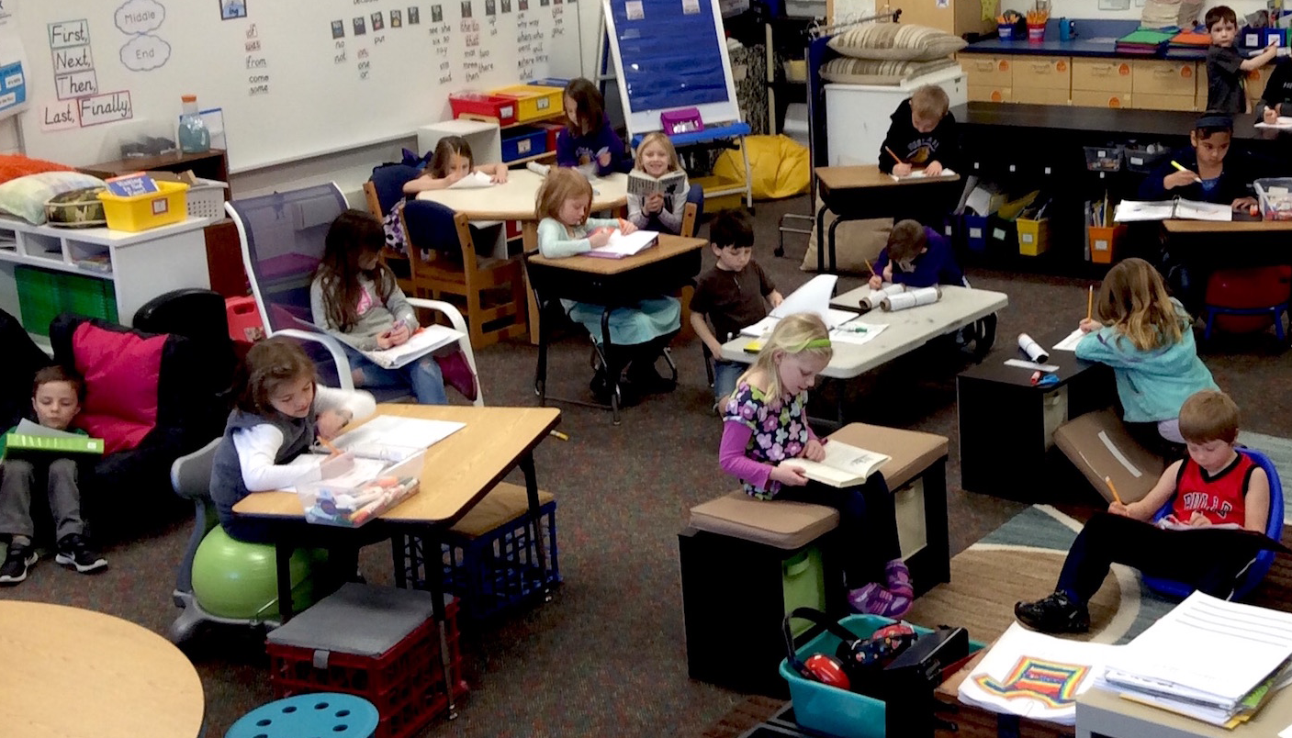
E = Environment
Locations include- Resource room, Gen. Ed. Science & Social studies, Lunch, Recess, & Music/Art/PE
Anticipated device locations- Classrooms, Therapy (SLP/OT), and Lunch (if trial successful, the team is anticipating the device be used at home as well)
Home- mom is interested in using something at home, currently not using anything, she'll have him repeat words and she usually will understand him more but still limited, currently homeless
What are some examples of classroom/school environments that could impact students with disabilities?
Notes:
🍐 This is a Pear Deck Text Slide
🍐 To edit the type of question, go back to the "Ask Students a Question" in the Pear Deck sidebar.

Slide 9
T = Task
Which choice is an example of the first “T” in SETT?
Expected tasks they are unable to participate in -
providing verbal responses in curriculum tasks and tests
socially participate with others
verbally make requests and self-advocacy
Notes:
🍐 This is a Pear Deck Multiple Choice Slide. Your current options are: A: Visual timer., B: Copy notes from the board/screen during class time., C: Flexible classroom seating., D: Not able to transition from task to task unless prompted 3-600 times.,
🍐 To edit the type of question or choices, go back to the "Ask Students a Question" in the Pear Deck sidebar.

Slide 10
T = Tool
What is an example of a tool that could be used to assist students with disabilities?
Used in the past- none
Currently using- PECS, gestures, and approximations of words, touch screen
Current Data- in SLP therapy [choosing one of two visual icons]
71% vocab tasks
50% answer questions
43% sorting
Anticipated device- icon-based, language output, vocabulary that will grow with him, durable case and strap
Anticipated data-
Frequency of using device (with prompt/model & independently)
Percent of intelligibility in contexts (social vs academic; classrooms vs therapy)
Notes:
🍐 This is a Pear Deck Text Slide
🍐 To edit the type of question, go back to the "Ask Students a Question" in the Pear Deck sidebar.

Slide 11
SETT Troubleshooting
Don’t try to solve every single issue - focus on relevant info to the referral area
Always move forward with a specific plan
Who is involved in implementation?
If AT is not necessary, what other strategies will be used to address the referral issue?
If an AT tool was chosen, is training needed -- for staff? for the student?
How will data be gathered? Who is responsible for that?
When will the team review the data? (Re-SETT)
The SETT framework supports an ongoing, dynamic process, just like the IEP process but usually with less paperwork.
AT decisions should be based on function not on specific brands or student’s eligibility area.
When in doubt -- gather more data/information

Slide 12
Step 2:
Device Decision-Making

Slide 13
Trial a Tool
Once the team has done a SETT and decided that a tool is needed
to meet the student’s needs, the most common next step is to trial it.
Based on the SETT, determine the purpose (e.g., communicate a growing list of vocabulary, word prediction, text to speech, etc.)
Research some tools that would fit the student & their specific needs (e.g., online, teachers, SLP, PT/OT, school psych/social worker, consultant etc.)
Decide on a tool to locate (within the school or district, online, KRESA lending library- SNAP Media, Michigan lending library)
Trial the tool, measuring for effectiveness

Slide 14
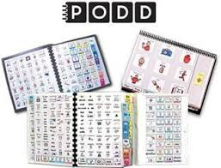
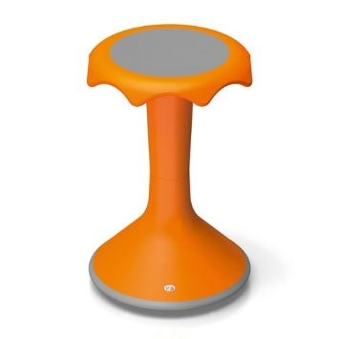
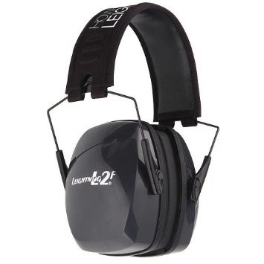
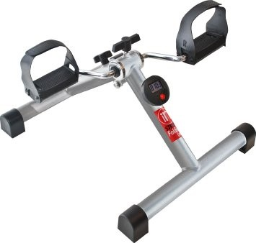
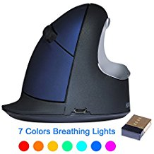
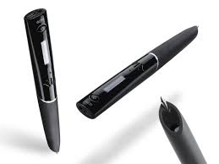
SNAP Media
KRESA’s Lending Library
Notes:
Signing up is easy, Borrowing is free -- Loan tools to trial with students
iPads with a variety of apps, especially AAC (like PODD, LAMP Words for Life, Proloquo2go, Sonoflex)
Pressure vests, Weighted vests, blankets, suspenders, even a snake
Ergonomic mouse, eases strain on wrist/forearm
Various headphones (with or without mic) and earphones (noise-cancelling)
Sensory tools - wiggle seats, hokki stools, under desk pedals, etc.
Livescribe smartpen - synchs audio and handwritting digitally

Slide 15
What to do with the Trial Results
Effective!
Yay! Collect your data and look into purchasing the device to be dedicated for that student.
Consider necessary accessories such as headphones, mic, type of case, etc.
Don’t forget warranties
Not effective
That’s ok! The team should re-SETT to determine what worked and what didn’t work then choose a different tool to trial or different strategy to use.
A tool is not necessarily ineffective if poor results were due to: not enough time to collect data, not fully training on use, not implementing as intended, etc.
Purchases $500 and less should be proposed to your building or district admin
Over $500 total should go to a KRESA Proposal Process
Just like when a doctor changes a medication or dosage, ineffective results does not mean starting over from scratch!

Slide 16
Proposal Process
KALAMAZOO RESA
https://www.kresa.org/ – Chan
Notes:
Go to website
Pull up example of completed and blank proposal
Explain process
Brainstorm data collection

Slide 17
Adding to a device
Repairs
For KRESA loan/dedicated devices
The contact point person for the device (usually the case manager) should connect with an AT committee member
Repair Request Form
Put form and all materials (including cables/accessories) the original SNAP Media box and send back in to REMC
Considering backing up anything important before sending back.
Check out a loaner (if available) while device is out being fixed.
Item hard to find? New ideas for tools (devices, gadgets, programs/apps, etc.) to add to SNAP Media for student use?
Fill out a Request Form!

Slide 18
Step 3:
Making it IEP Official
**What is written in the IEP may vary from district to district. Check with your administrator regarding any specific questions or issues.**

Slide 19
General Suggestions on writing AT into the IEP
Strengths, Transition, and Notice pages

Slide 20
General Suggestions on writing AT into the IEP
PLAAFP page

Slide 21
General Suggestions on writing AT into the IEP
Special Factors page -
To check or not to check “Need for AT”...
No Tool-specific names
Conditions and settings where the AT support will be used
Notes:
Accommodations and Alternative Assessments page - Consider how students are engaging in class tests and choose State testing accommodations based on need.
https://www.michigan.gov/documents/mde/Michigan_Accommodations_Manual.final_480016_7.pdf

Slide 22
General Suggestions on writing AT into the IEP
Link to any related Goal/Objectives -
AT is not the goal, it is a means to achieving a goal
No Tool-specific names
When noting progress, specify which data is with and without the Tool

Slide 23
Related Resource Links
KRESA Assistive Technology Team
Joy & the SETT
The artist formerly known as MITS (Alt+Shift)
QIAT - quality indicators of AT implementation
Understood’s Tech Finder
More Tool Ideas: Fun and Function, Attainment, StimTastic
Communication Blogs: PrAACtical AAC, AAC Language Lab

Slide 24
-- 2018 Ignite your Learning --
AT Resources
Gayle Evans’ Extensions for Everyone list
Gayle Evan’s Speech to Text resources and tips
WATI Guides to AT Resources
Nancy Gallihugh - KRESA free Audiology services
KRESA AT Team - Common resources list
Lacey Khon, KRESA Instructional Tech. -
Nearpod
Flipgrid
Seeing AI

